Slide 1
Diagrams
By Nate Silverman

Slide 2
Types Of Diagrams
Data-Flow Diagram know as (DFDs)
Entity Relationship Diagram known as (ERDs)

Slide 3
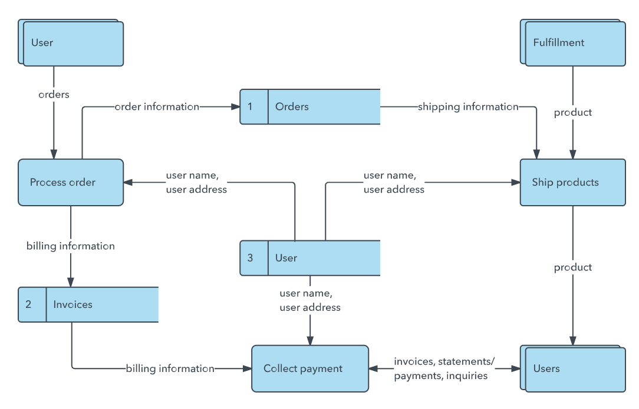
Data-Flow Diagrams
Know as DFDs
Graphically represent the flow of data in a system
Shows data inputs, outputs and storage points
Uses symbols like rectangles, circles, and arrows with short text labels
Helps visualize the route data takes
Often has levels
Notes:
https://www.lucidchart.com/pages/data-flow-diagram

Slide 4
0-Level DFD
Level 0 is over simplification of the data flow

Slide 5
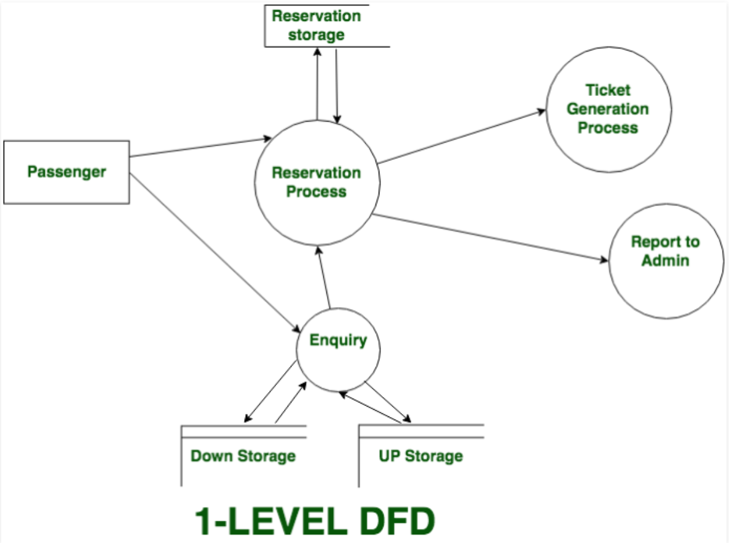
1-Level DFD
Level 1 shows the main functions and storage points

Slide 6
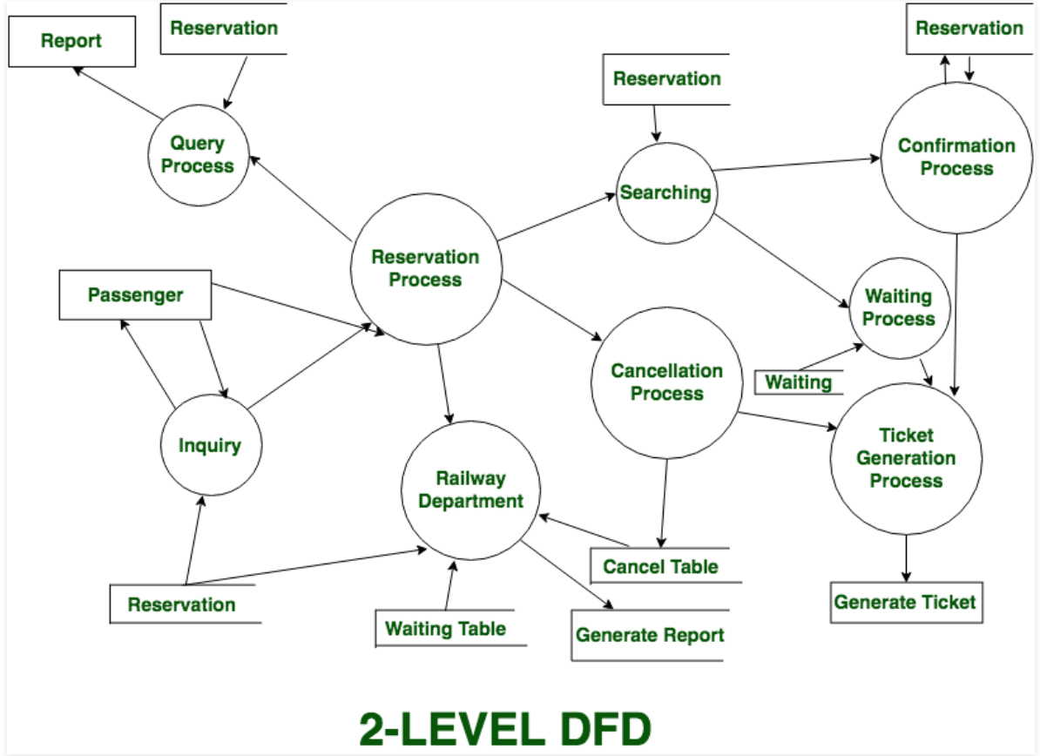
2-Level DFD
Level 2 shows the specific functions of how the system functions
Notes:
https://www.geeksforgeeks.org/levels-in-data-flow-diagrams-dfd/

Slide 7
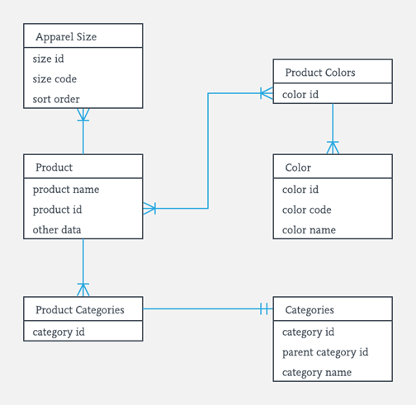
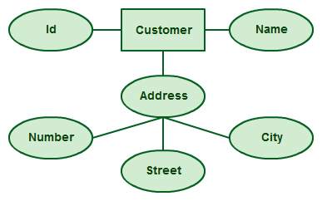
Entity Relationship Diagram
Known as ERD, ER Diagram or ER Model
Used for database design
Uses various connecters and symbols with predetermined meanings
Helps visualize two important aspects, the entities within the a given scope and the relationships among those entities.
Notes:
Square is an entity, oval is an attribute

Slide 8
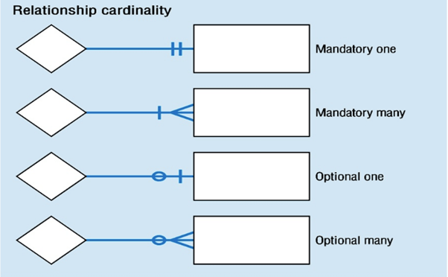
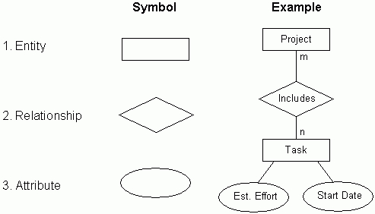
ERD Basics

Slide 9
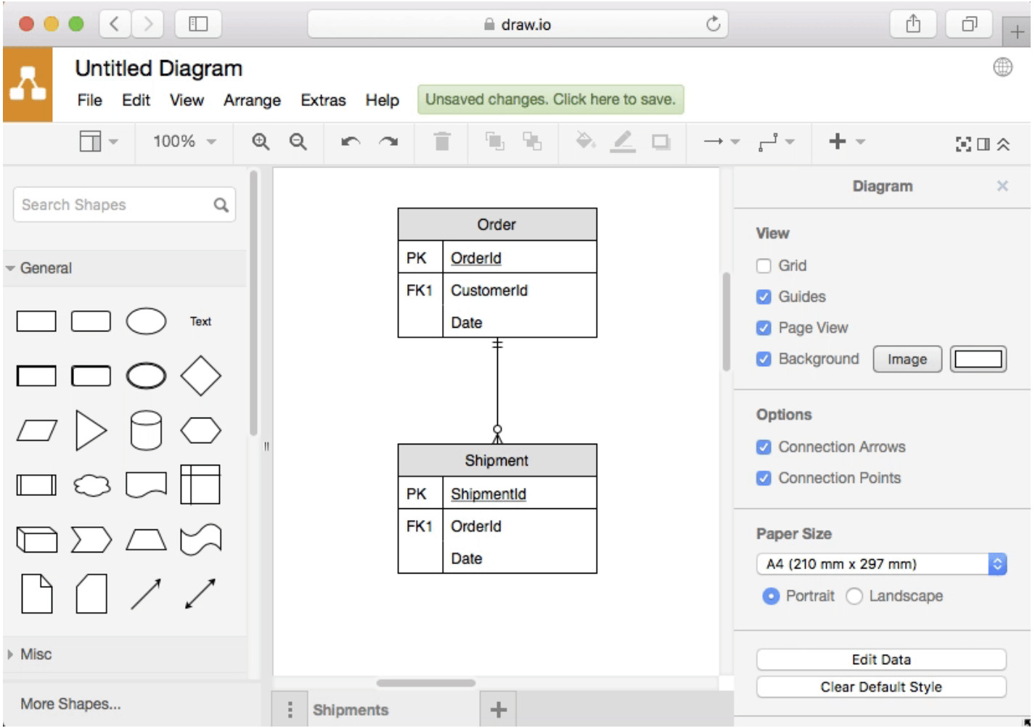
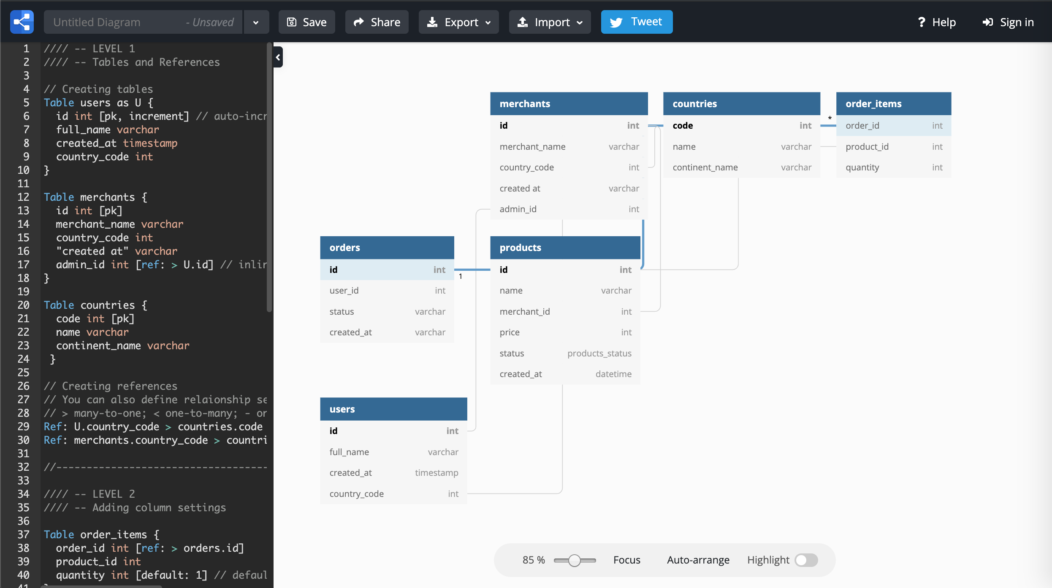
Programs
Basic= draw.io Advanced= dbdiagram.io
Notes:
https://dbdiagram.io/d

Slide 10
Resources
All rights of diagrams belong to their respective owners
https://www.geeksforgeeks.org/levels-in-data-flow-diagrams-dfd/
https://www.lucidchart.com/pages/data-flow-diagram

