Slide 1
(Computer) Security
“keep it secret, keep it safe”

Slide 2
Chatham House Rule
When a meeting, or part thereof, is held under the Chatham House Rule, participants are free to use the information received, but neither the identity nor the affiliation of the speaker(s), nor that of any other participant, may be revealed.

Slide 3
Why Are We Talking About Computer Security in Discrete Mathematics?
Falls under the heading of “Why do I care?”
Many of the techniques used in Computer Security involve encryption
Best encryption techniques use discrete math
To make it secret
To break the secrecy
It’s a lot of fun!

Slide 4
Access Control
Access control is concerned with insuring that only authorized users can get to resources (data, equipment, and so on.)
User log on and passwords (still the most widely used)
Tokens
Time windows
Biometrics
Fingerprints
Retina scans
Facial recognition
Opens the possibility of gruesome movie scenes

Slide 5
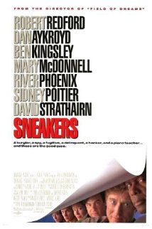
Intrusion Detection
Physical intrusions
Cyber intrusions
Cyber security is of no use if the intruder can physically attack the system.

Slide 6
Message and Data Security
How can we keep stored information secure?
How can we keep messages (data) secure?
In reality, these are basically the same question, so we will concentrate on messages because they are more fun to talk about.

Slide 7
The Three Important Goals
C Confidentiality: Only the right people can know (includes privacy)
I Integrity: The message received is the message sent
A Authenticity: The message is from the author, not an imposter
Someone has a sense of humor.

Slide 8
Terms
Clear text: Messages that can be read by anyone or the text of the message you wish to send
“The quick brown fox jumps over the lazy dog.”
Also called plain text
Secret text: Message that has somehow been scrambled or otherwise hidden
“Gsv jfrxp yildm ulc qfnkh levi gsv ozab wlt.”
During this presentation, you can assume all messages are sent in some kind of secret text.
Alice: The person wishing to send the message (from)
Bob: The intended recipient of the message (to)
Charles: The bad guy trying to read, or disrupt, the message (crook)
Eve: Anyone trying to eavesdrop on the message (nosey neighbor)

Slide 9
Terms (continued)
Code: A pre-agreed upon secret meaning for a message.
Cannot be broken if used correctly
Code book must be secret and safe
Only pre-agreed messages can be sent
Cypher or encryption: A mathematical method to change the clear text to secret text
Method must be agreed upon in advance
Most rely upon a key that must be secret and safe
Any message can be sent
Any encryption can be broken by a “brute force attack”…may take forever
PET PEEVE: Codes (encoding) and cyphers (encryption) are not the same, but we won’t be picky as no one else really cares about the difference.

Slide 10
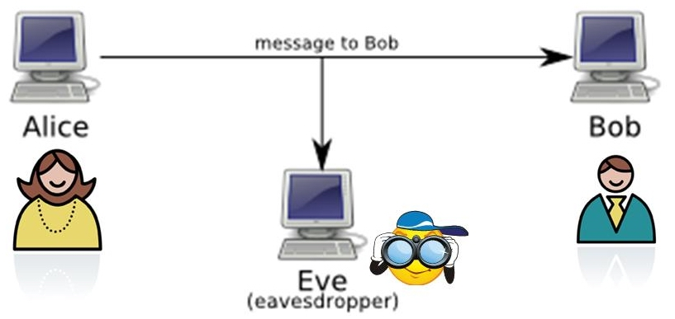
Confidentiality
A message from Alice to Bob cannot be understood by Charles or Eve, even though it goes via public channels (phone, email, texting, internet, radio …..)

Slide 11
Examples of Codes and Cyphers
Code:
Clear text: Rob the bank
Secret text: Uncle Fred drove Aunt Sally to the mall today.
Clear text: Get out of town….NOW.
Secret text: The vet says your cat is in great health and not fat at all.
Encryption or cypher:
Clear text: The quick brown fox jumps over the lazy dog.
Secret text: Gsv jfrxp yildm ulc qfnkh levi gsv ozab wlt.
Because codes can’t be broken and are somewhat limited, we will concentrate on encryption. Besides, computers are very good at encryption.

Slide 12
Background
Simple substitution
Each character is replaced by another character using a table known to Alice and Bob, but no one else
ABCDEFGHIJKLMNOPQURSTUVWXYZ
ZYXWVUTSRUQPONMLKJIHGFEDCBA
The table must be kept secret or the whole thing doesn’t work.
Easy to break (we’ll do one later)
Caesar's Cypher is a simpler to remember variation of a simple substitution cypher and is therefore easier to break.
Assign a number to each letter: A=1, B=2
Add a number to the letter value to get a new letter
Subtract the number from the encrypted letter to get the clear text

Slide 13
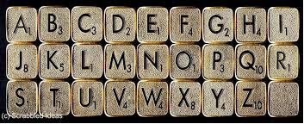
Breaking a Simple Substitution Cypher
Brute force attack: Try every combination until you hit the right one.
Number of tries is on the order of 26! … too large to be useful
Knowledge of the language (e.g., English or Klingon) gives the code breaker an edge
The best attack is…..
ETAOINSHRDLCUMWFGYPBVKJXQZ

Slide 14
What Makes a Good Encryption?
Must be reliable and tolerate errors. Fortunately, humans are good at understanding text messages with minor (and often serious) errors.
Must be impossible, or at least difficult, to decrypt without the key(s)
For streaming data, such as voice or video, must be fast
Should be a public method with privately held keys. (Why? So more people will try to break it.)
PARANOIA! Should not have ever been touched by the NSA (National Security Agency).
Legally mandated encryption with keys held in a “vault” maintained by NSA. DEFEATED.
Clipper chip…hardware encryption from NSA (with a back door). DEFEATED.
Skipjack phone…on the fly encryption of voice (with an NSA back door). DEFEATED.

Slide 15
Some Industry Standard Encryptions
DES Data Encryption Standard
Developed with the help of the NSA
May have a “back door” Oops!
withdrawn by National Institute of Standards and Technology – NIST
AES Advanced Encryption Standard
withdrawn by National Institute of Standards and Technology – NIST
RSA Ron Rivest, Adi Shamir and Leonard Adleman
First widely used “public key/private key” security
Depends upon factoring large numbers
So far, so good (more later if there is time…..)

Slide 16
Symmetric Key vs Public/Private key
Symmetric key cryptography
Same key to encrypt/decrypt
Can always be defeated by a “brute force” attack
The longer the key, the better the security
Periodically changing the key improves the security
Key exchange must be private
Public key/Private key cryptography
One key is held secret, the other is published (literally!)
Can always be defeated by a “brute force” attack
The longer the key, the better the security
Periodically changing the key improves the security
Has more uses than Confidentiality

Slide 17
Some Math to Scramble a Message
Simple substitution works for up to about 12 year olds
Keyed substitution (5736362121)
Works well if only humans are involved
Computers can break this fairly easily
Other “symmetric” methods
Same key to encrypt as decrypt
Must keep key safe
Can be broken fairly easily
Change keys often (must have secret distribution)

Slide 18
One-way Formulas
We need something that is one-way
Secret text does not help to find the key
Should tolerate errors
Usually not as good and the inventor thinks it is…. (*sigh*)
Best so far involve:
One-way encryption
Data rotation (?????)
Modular arithmetic (x mod y)
Large primes (?????)
Multiple steps

Slide 19
RSA : Rivest, Shamir, and Adleman
RSA is the industry standard
Key is the problem of factoring large numbers that are semiprime (the product of two primes)
Public key / private key asymmetric encryption
Uses multiple steps (more at the end of the course if there is time)
Uses data rotation
Great stuff …. Except ….
Rivest worked for the NSA at one point

Slide 20
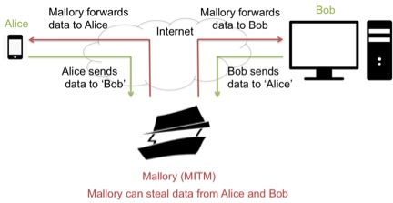
Integrity
Over public media, is someone changing your messages and stealing data?

Slide 21
Integrity
Changed messages
Is the message received by Bob the message Alice sent? Enemy action
Public key/Private key encryption can be used to “sign” a message. Cannot be forged .
Security Certificates are another way to sign a message. Cannot be forged. (?????)
Has the message been scrambled? Enemy action.
Has the message been scrambled? Errors.

Slide 22
Authenticity
Over public media, who are you really talking to?

Slide 23
Authenticity
Who really sent those messages
Is someone else posing as Alice? Enemy action
Public key/Private key encryption can be used to “sign” a message. Cannot be forged .
Security Certificates are another way to sign a message. Cannot be forged. (?????)
What if I hack the certificate authority?
What if I hack the method used (public key/ private key) to sign the certificate? Did these updates really come from Microsoft?

Slide 24
So, why do I care?
Privacy
It is harder to read encrypted files
It is harder to read encrypted directories
Do you really want someone reading your purchase information? Anyone want to go to Target?
Battlefield communications
What is the enemy trying to do?
Keeping the enemy from knowing what you are doing
Weapon systems depend upon electronics so the electronics must be protected
In Iraq, drone video was being watched by terrorists in Iraq at the same time it was being viewed by remote pilots
Heddy Lamar invented frequency hopping to foil Germans jamming torpedoes.
IEEE honored her for the invention
You would not have a cellphone without her

Slide 25
So, why do I care? (continued)
Industrial spying
Control the sources of information and you can control your people.
Great Firewall of China
Alan Moore — “People shouldn't be afraid of their government. Governments should be afraid of their people.” (anyone recognize this?)
Cyber-Physical Systems (CPS)
The electrical power grid is controlled by electronics
The chances are that the brakes in your car are connected to a sensor that “asks” the car’s computer to apply the brakes. More and more cars are wirelessly connected to something outside the car.
CPS can be observed and therefore leak information to attackers
CPS cannot be easily hidden

Slide 26
Oops?
Any security can be broken. Period.
Brute force attacks
Try every possible key
Use many, many computers to try many keys at once
With luck, by the time the key is broken the data is too stale to be of use. Do you really care if someone cracks your MasterCard account 25,000 years from now?
Good keys may take longer to find by brute force than the life of the universe
Oops, what if the key is guessed on the 10th guess?
Statistical attacks
Analyze intercepted messages for patterns.
Any knowledge of the possible content of the message helps

Slide 27
Oops? (continued)
Social engineering attacks
The adversary might be a con artist
Many, many users will give you their login information if you are “Jack from IT.”
The three most common places keep their login information are post-its on the monitor, under the keyboard, and in the desk drawer closest to the keyboard. ARGH!
Physical attacks
If I can get to your Cisco router, I can drop your network for hours, maybe days, in less than a minute.
What good is the encryption on your hard drive after I smash it?
Many companies in the World Trade Center used the same organization for disaster recovery. This organization had its offices and backups in the World Trade Center.

Slide 28
Things to Think About at 3:00 a.m.
Any security can be broken.
Security experts “know” their security cannot be broken. For example, the inventor of PGP offered a reward to anyone who could break into his email in less than the life of the universe. It took less than six months for someone to collect the prize. The newer version is better.
More and more of our lives are on line.
The US press was accidentally tipped off as to the start of the first Iraq war before it happened. The information was leaked when a pizza delivery van arrived at the Pentagon at 2:00 a.m.
The good guys work eight hour days. The bad guys work 24 seven
Governments and organized crime are into hacking your security
Any security can be broken.

Slide 29
In closing….
para·noia
noun \ˌper-ə-ˈnȯi-ə, ˌpa-rə-\ medical : a serious mental illness that causes you to falsely believe that other people are trying to harm you
: an unreasonable feeling that people are trying to harm you, do not like you, etc.
Bishop, Matt. Introduction to computer security. Addison-Wesley Professional, 2004.
Stallings, William. Network and internetwork security: principles and practice. Vol. 1. Upper Saddle River, NJ: Prentice Hall, 1995.
Howser, Gerry, and Bruce McMillin. "Modeling and reasoning about the security of drive-by-wire automobile systems." International Journal of Critical Infrastructure Protection 5.3 (2012): 127-134.
Samanthula, Bharath K., et al. "A secure data sharing and query processing framework via federation of cloud computing." Information Systems (2013).
Eighth Annual IFIP WG 11.10 International Conference on Critical Infrastructure Protection (Chatham House rules of non-disclosure)

Slide 30
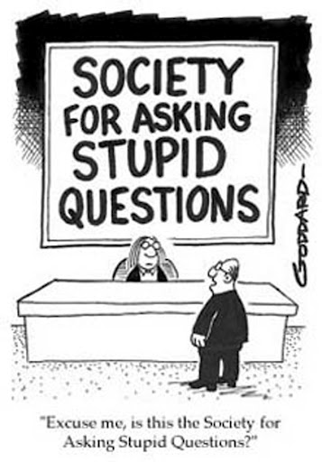
Questions?

