Slide 1
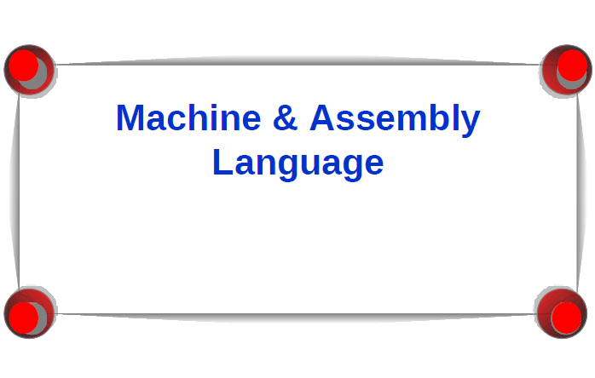

Slide 2
Machine Language
Computer languages cannot be directly interpreted by the computer – they are not in binary.
All commands need to be translated into binary instructions called machine language.
Each type of CPU has its own machine language.

Slide 4
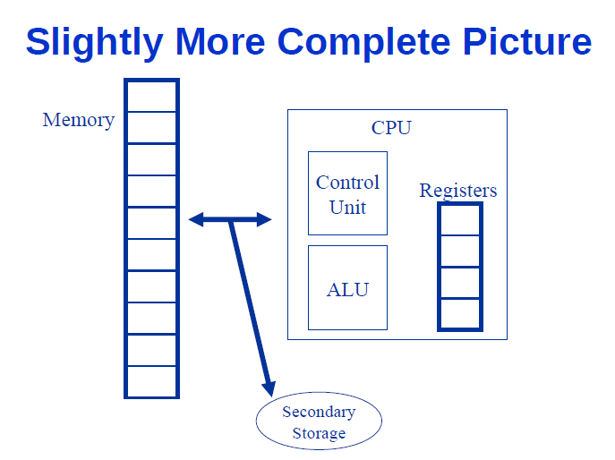

Slide 16
In Python
The same program in Python would look like:
def testFunction(y):
z = 0
x = 3
while (x != 0):
z = z + y
x = x - 1
y = z
return y
Or just y = y *3

Slide 17
Compilers, Interpreters, Assemblers
Because it is difficult to program in Assembly, we have “high level” programming languages.
Python, JavaScript
C, C++, Java, Fortran, Cobol, Pascal, Lisp, Ruby,…
Compiler/Interpreter translates from the high-level language to machine language
Another advantage of high level languages:
Portability

Slide 18
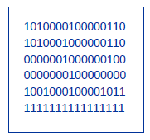
Program Translation
def testFunction(y):
z = 0
x = 3
while (x != 0):
z = z + y
x = x - 1
y = z
return y
Interpreter
Assembler

